Slide 1

CNN on MNIST - Let’s trace shape of nodes

Slide 2
Reference
Youtube on MNIST
Youtube on Convolution
Youtube
Code

Slide 3
Warm Up

Slide 4
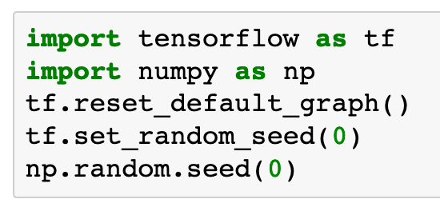

Slide 5
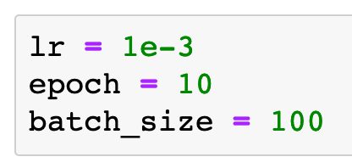

Slide 6
Data

Slide 7
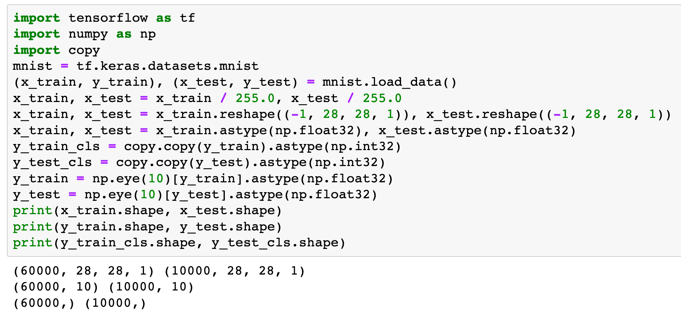

Slide 8
Graph

Slide 10

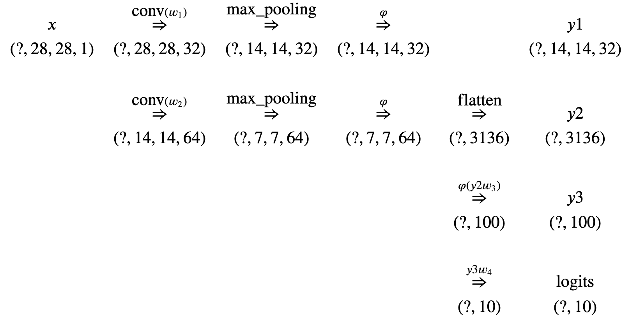
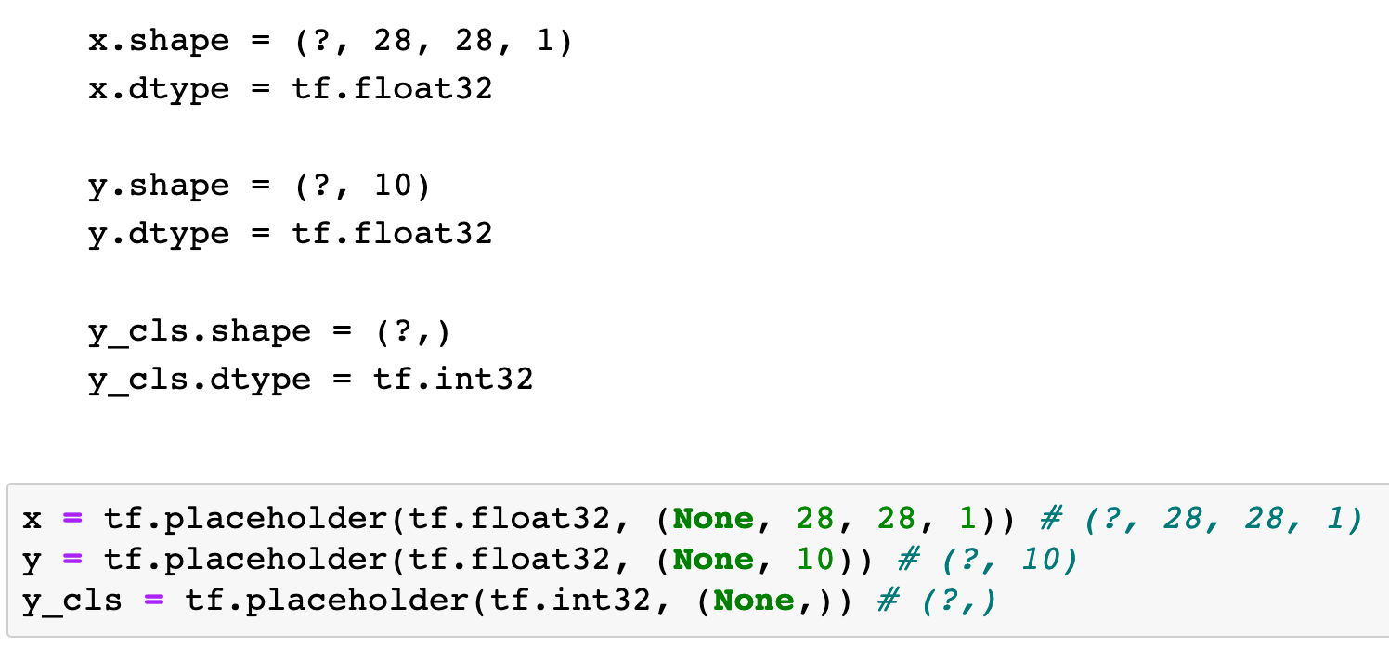

Slide 11
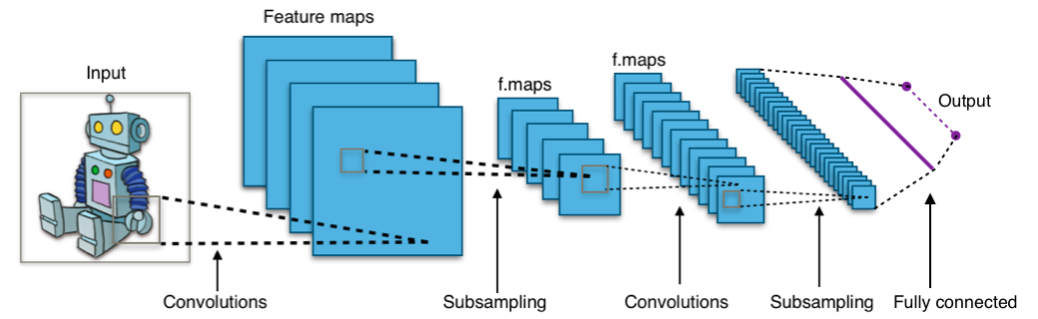
By Aphex34 - Own work, CC BY-SA 4.0

Slide 12
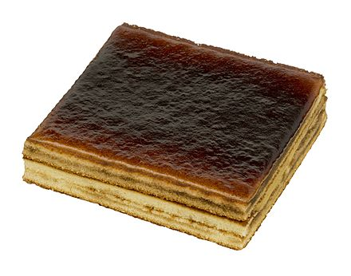
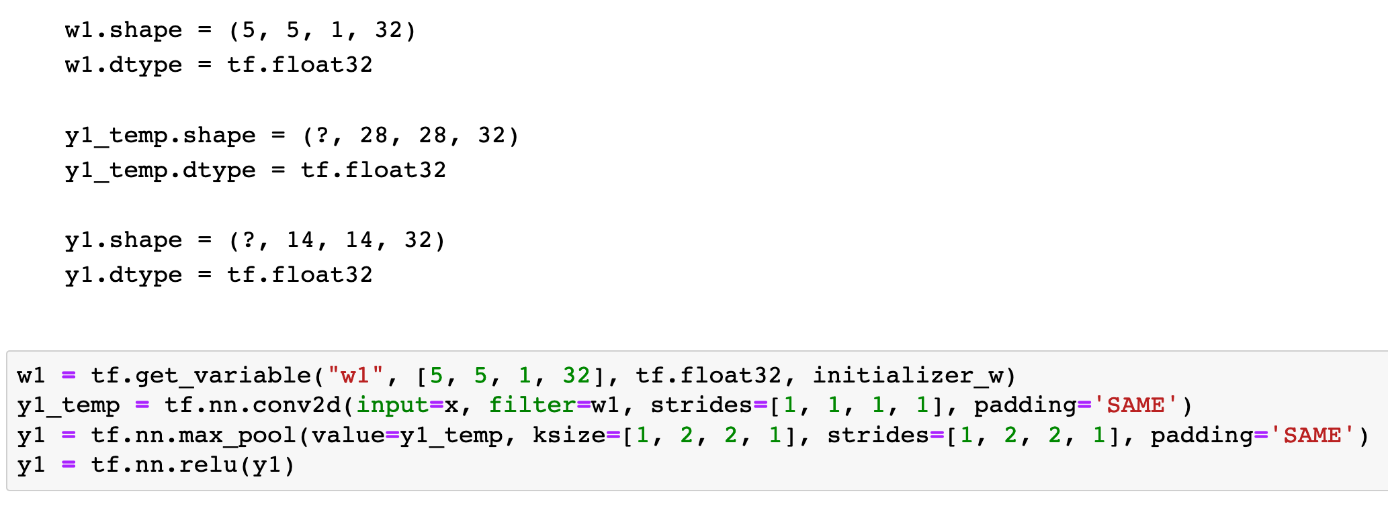

Slide 14
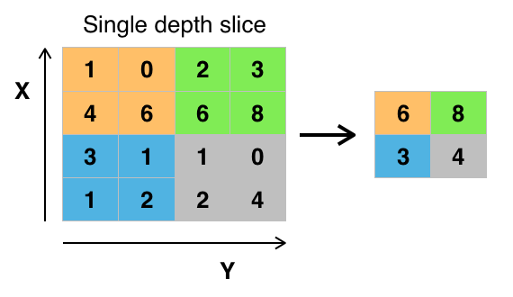
By Aphex34 - Own work, CC BY-SA 4.0

Slide 17
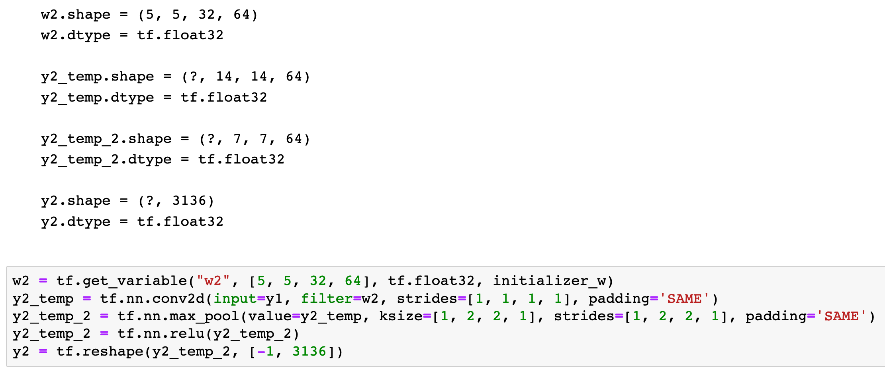

Slide 21
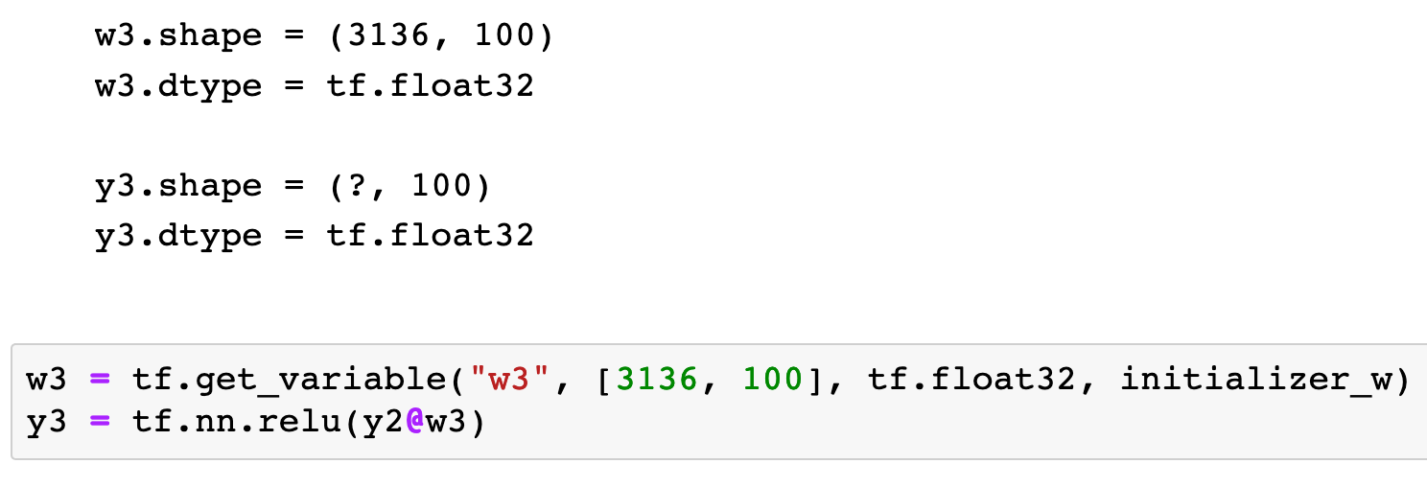

Slide 22
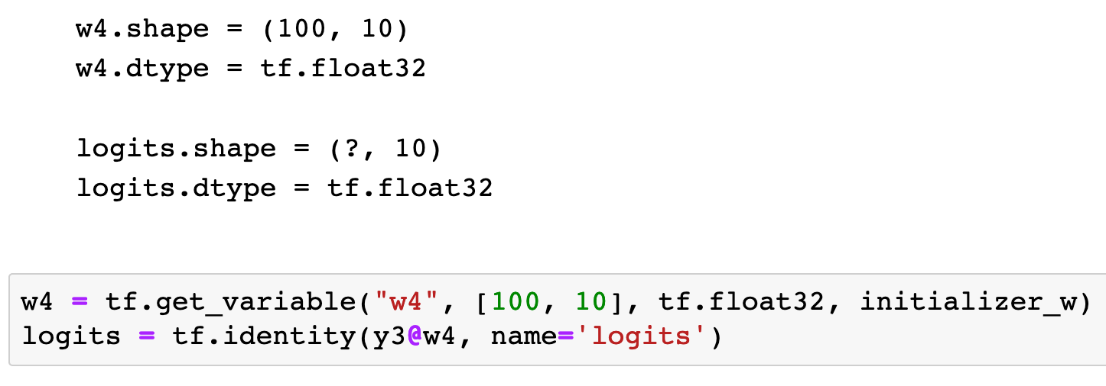

Slide 23
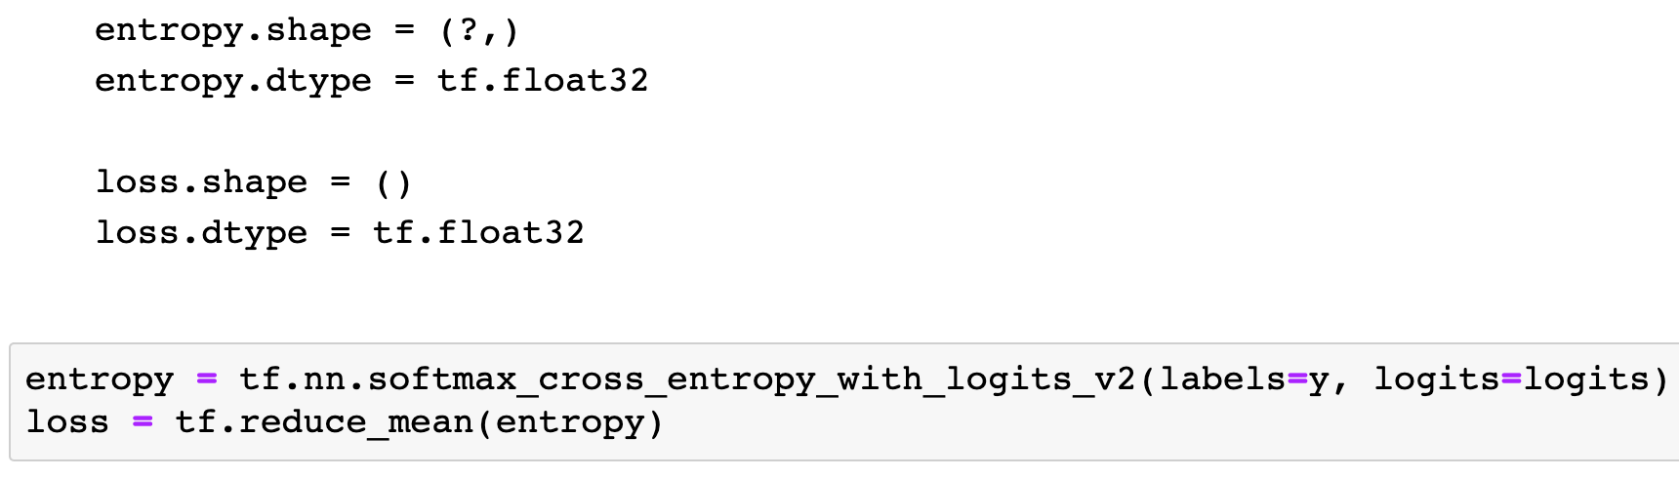

Slide 24
GradientDescent
Adam

Slide 25
GradientDescent
Adam

Slide 26
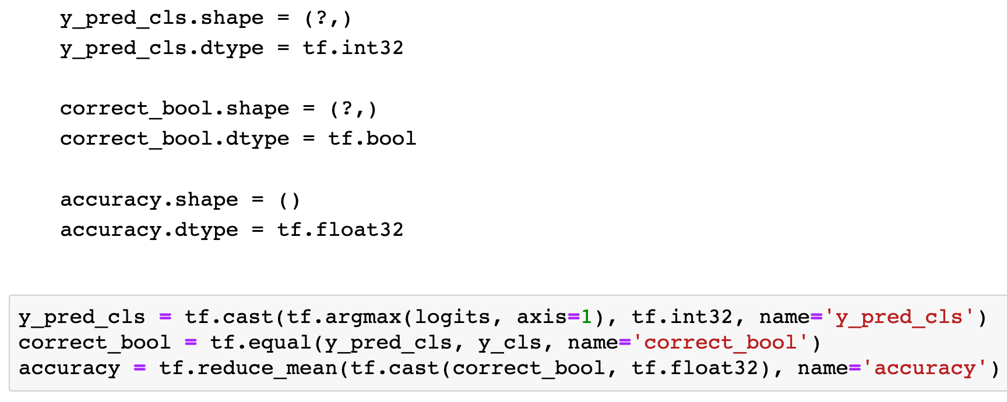

Slide 27
Session

Slide 28
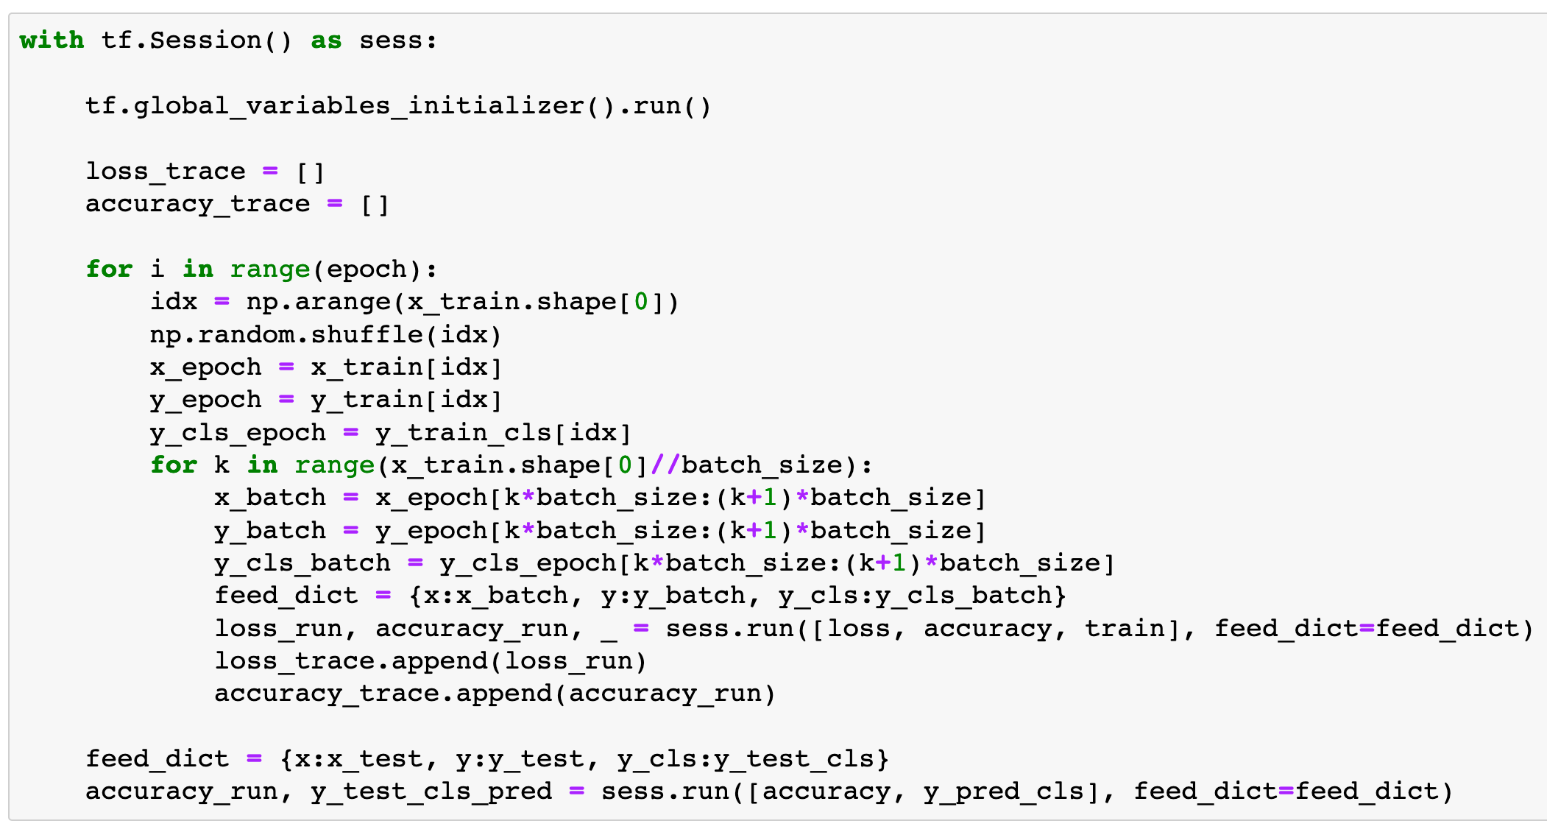

Slide 29
Report Result

Slide 30
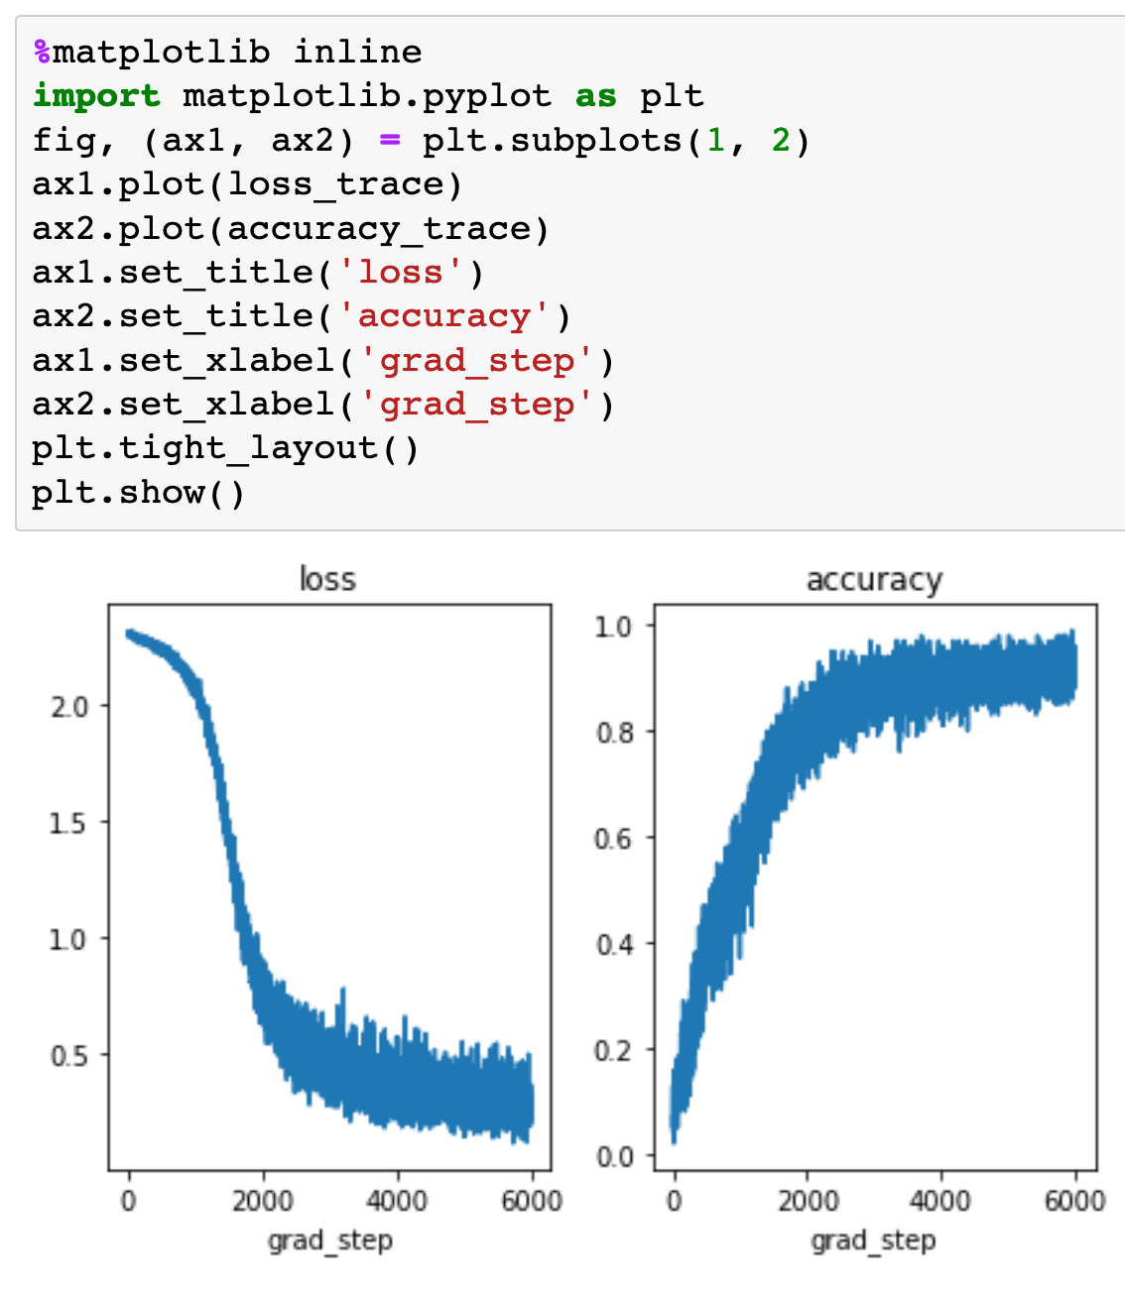
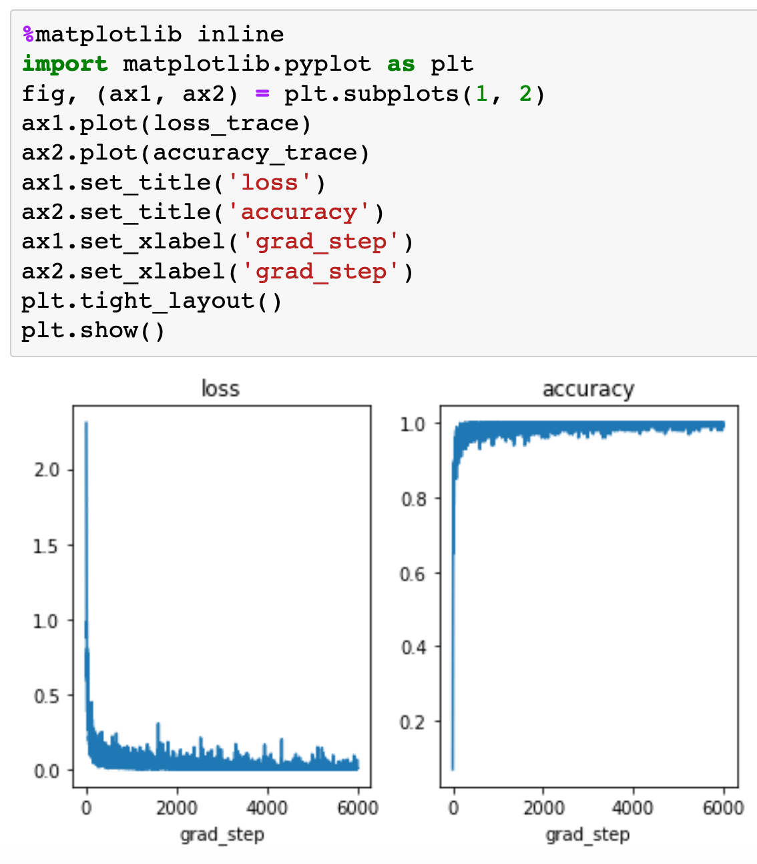
GradientDescent
Adam

Slide 31
GradientDescent
Adam

Slide 32
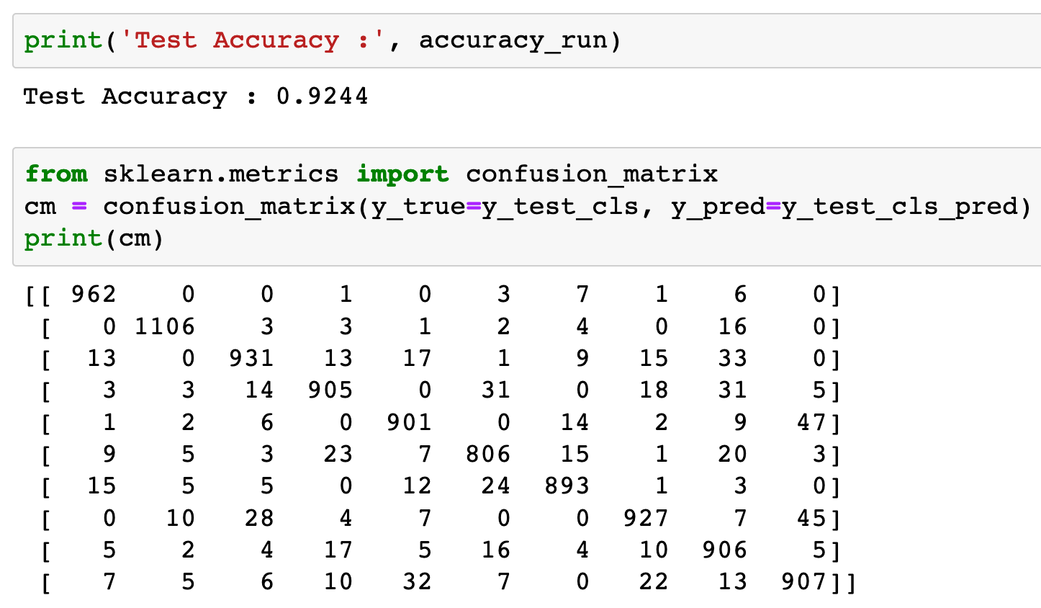
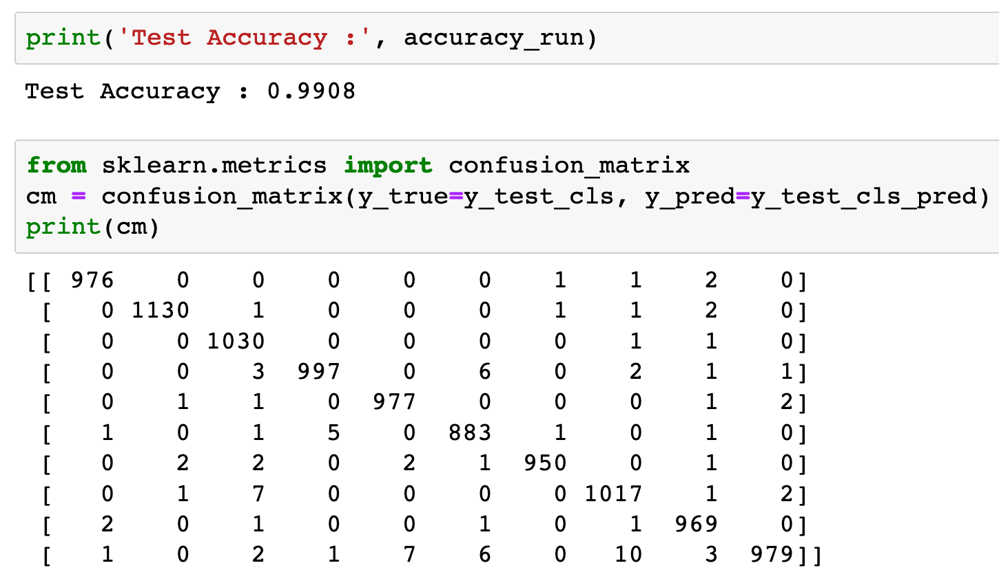
GradientDescent
Adam

Slide 33
GradientDescent
Adam

Slide 34
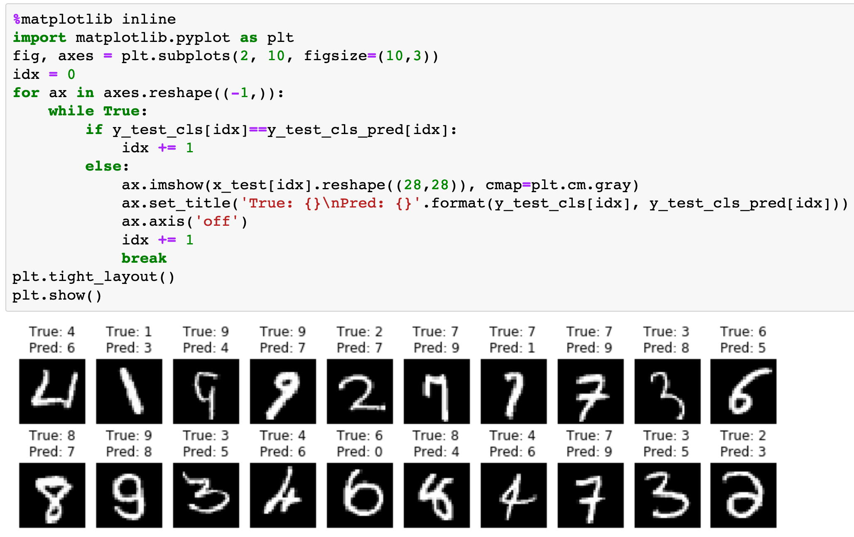
GradientDescent

Slide 35
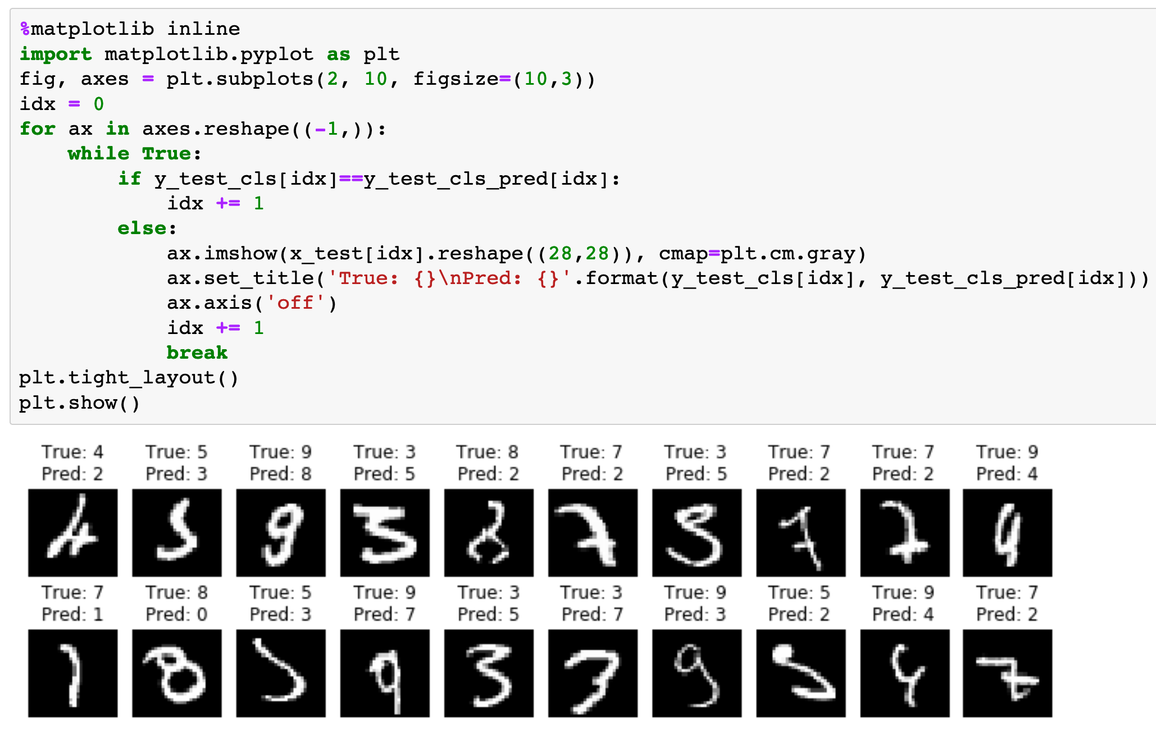
Adam

Slide 36
Now
Let’s Play with Code

